Slide 1
ZigBee protocol
MAC layer, physical layer, power consumption and security considerations

Slide 2
Introduction
ZigBee is a short-range, energy-efficient wireless communication protocol based on the IEEE 802.15.4
Data rates of 250 kb/s, 40 kb/s and 20 kb/s.
Star or Peer-to-Peer operation.
Support for low latency devices.
Fully handshaked protocol for transfer reliability.
Low power consumption.
Frequency Bands of Operation : 16 channels in the 2.4GHz ISM* band, 10 channels in the 915MHz ISM band, 1 channel in the European 868MHz band → shield from interference

Slide 3
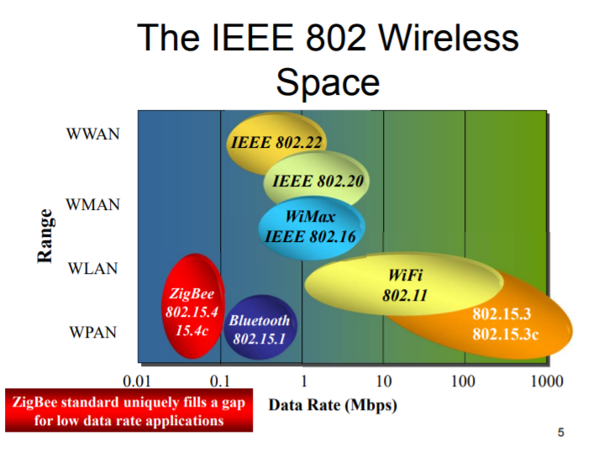
ZigBee Wireless Sensor and Control Network, Ata Elahi, Adam Gschwender, Oct 29, 2009, Pearson. ISBN-10: 0-13-713485-1,

Slide 4
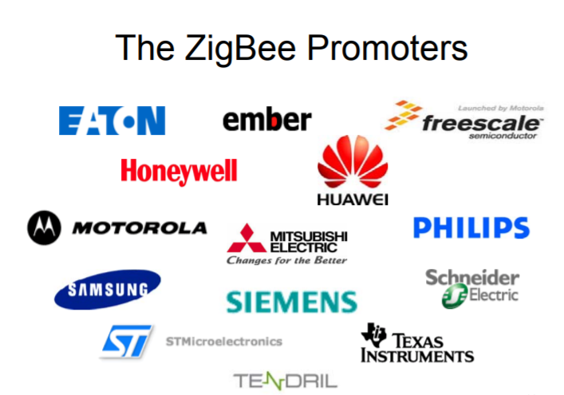

Slide 5
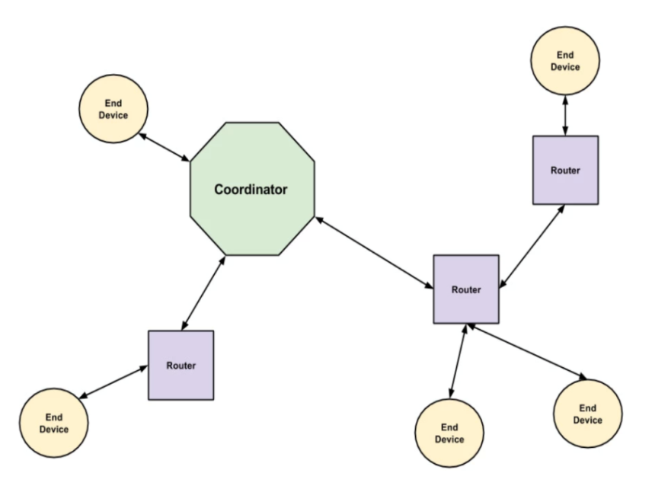
Functional description
Coordinator: establishing, executing, and managing the ZigBee network. Security level of the network and configuring the address of the Trust Center.
Variable range : 1~300m!
Up to 2¹⁶ (65536) nodes
Zigbee node was about $1.10 (About €0.99) versus $4 to $6 (Between €3.40 and €5.40) for a Bluetooth
Vishruta Rudresh, Research at Kudelski Security, 2017

Slide 6
Physical Layer
Activate/deactivate transceivers (low duty cycle saves energy)
Listen to channels and declare availability or not
Transmit and receive data
Coverage : 30-100m
Two physical layer formats : 868/915 MHz and 2.4 GHz
868 MHz (Europe) | 915 MHz (US) | 2.4 GHz (Worldwide)
20 kbps | 40 kbps | 250 kbps
1 channel | 10 channels | 16 channels

Slide 7
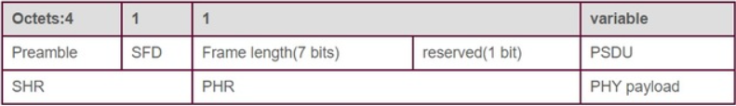
Zigbee PHY packets structure
Preamble is 32 zeros → synchronisation
SFD is a transition (Start Frame Delimiter)
Frame length indicate length of PSDU
PSDU contains the payload (0-127 octets)

Slide 8
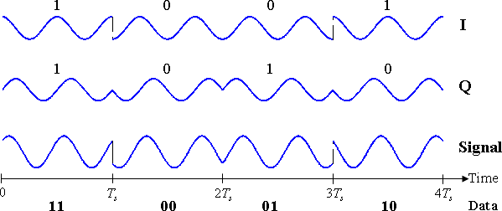
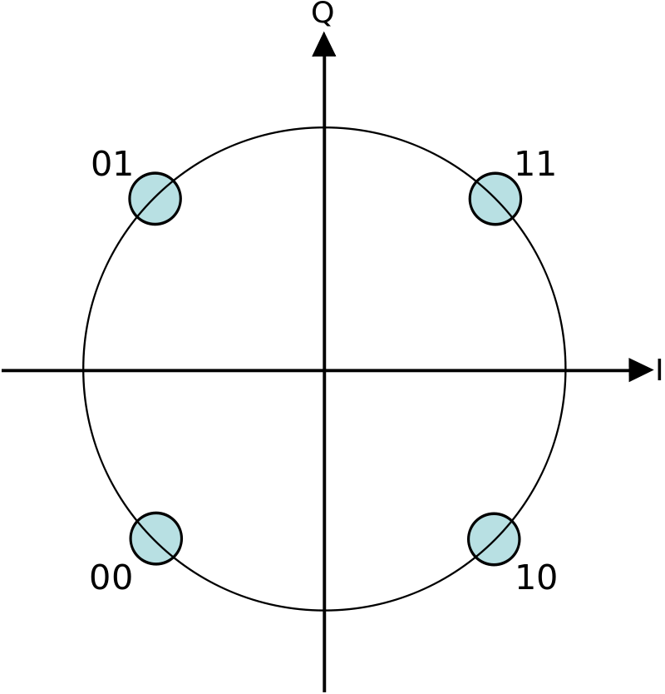
Modulation QPSK
Quadrature phase-shift keying
Can code 2 bits at once → rate 2 times higher
Add 2 waves with phase-shift

Slide 9
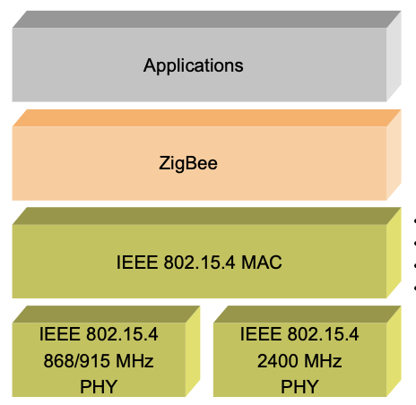
ZigBee Stack
The ZigBee protocol stack consists of four layers – Physical layer, Medium access control (MAC) layer, Network layer (NWK) and Application layer (APL)
→ Defined in the IEEE 802.15.4 standard

Slide 10
MAC Layer functions
→ Transfers data to the network/physical layer and vice versa
→ Manages access to the physical channel and network beaconing
→ Generates the beacon frame in a coordinator
→ Lowers power consumption (beacon-enabled mode)
→ Supports device security
→ Provides a reliable connection between two MAC layers (use of acknowledgement)

Slide 11
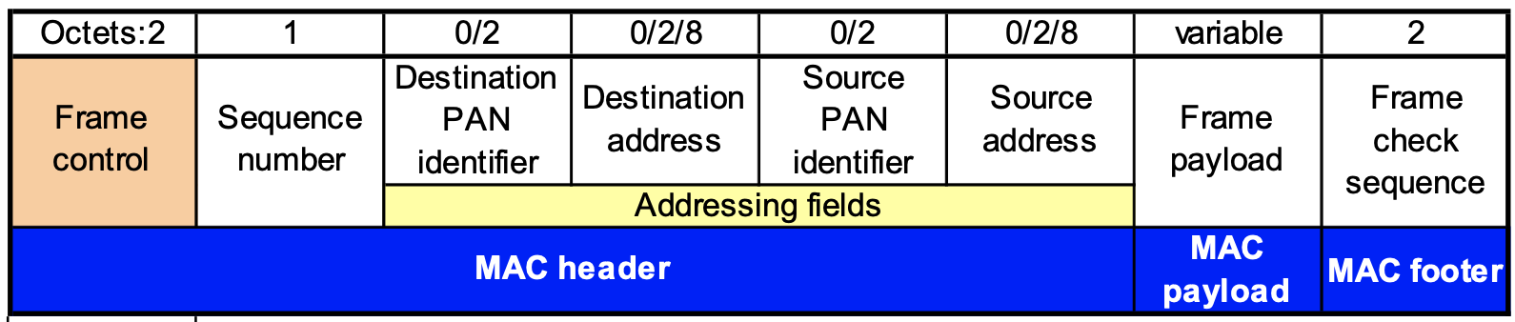
MAC Layer Frame

Slide 12

KAHOOT

Slide 13
Power consumption
Zigbee is a low consumption protocol => MEDIUM BIT RATE, LOW RANGE
How ?
• Duty-cycle control using superframe structure
• Indirect data transmission (with coordinator)
• Devices may sleep for extended period over multiple beacons
• Allows control of receiver state by higher layers

Slide 14
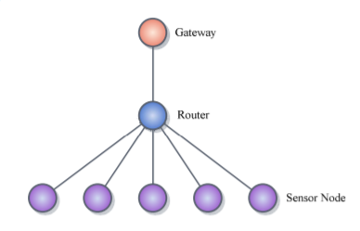
Power consumption
Data from a Zigbee WSN ( CC2530 ZigBee development kit)
Power up : 0.2A for a couple of seconds
Transmitting data without ACK : 10^-4 J (0.01 s)
Transmitting data with ACK : 10^-3 J (0.1 s)
Router: Uses 0.3A
Topology of the WSN for this tests

Slide 15
10^-7J/bit without ACK
10^-6J/bit with ACK

Slide 16
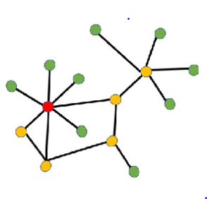

Power consumption
Typical zigbee WSN topology
Zigbee router and coordinators cannot sleep !

Slide 17
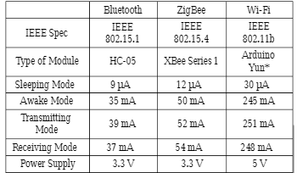
Power consumption
Comparison with other protocols for an ESP82 device :
Comparison table between short range protocols

Slide 18
Security considerations
A 128-bit AES key is used to encrypt/decrypt packets. 3 different keys : Master, Link, Network.
“Trust Center” acts as a trust manager (to authenticate devices wishing to join the network), a network manager (to maintain and distribute network keys) and a configuration manager (to enable end-to-end security between devices). → ONLY ONE PER NETWORK
Security can be customized for the application
Keys can be “hard-wired” into application

Slide 19
Trust Center functionality
Standard mode is designed for residential applications : maintains a list of devices, master keys, link keys and network keys. Each device that joins the network securely shall either have a global link key or a unique link key.
High security mode is designed for high security commercial applications. Trust Center also manages key establishment, using Symmetric-key Key Establishment (SKKE) protocol and entity authentication.

Slide 20
Security considerations
Link Key: key only shared between two devices to protect frames on the APS layer
Network Key: key used to perform network layer actions (routing, request to join the network, etc.) and to prevent illegitimate insertion of a device
Master Key: used to share the initial secret between two devices when they perform the key establishment procedure (SKKE) to generate the Link Key
Main weakness of the protocol : key exchange, which does not offer sufficient security and is equivalent to plain text key exchange. “Open trust” model.
Notes:
Although these safeguards are sufficient for protection against various attacks, not all of them are necessarily implemented by manufacturers, which creates multiple threats to devices using this protocol

Slide 21
Conclusion
One of first protocol with such low energy consumption(2002)
BLE appearance, better yield for low range application
Style useful forWPAN => easy to implement

Slide 22
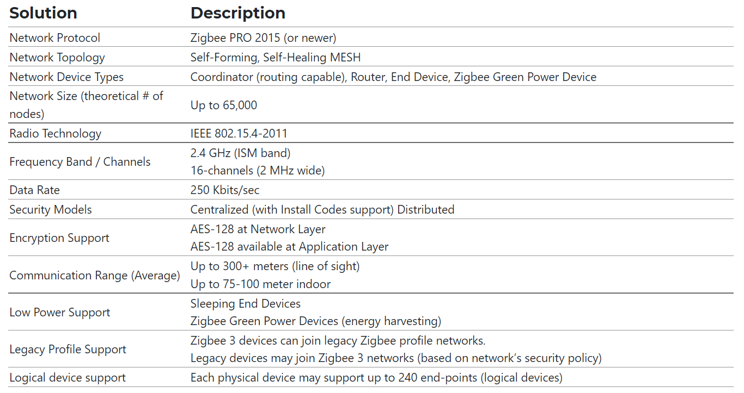
Essential figures

Slide 23
Sources
Song, Jiaying; Tan, Yen Kheng (2012). [IEEE 2012 IEEE International Conference on Communication Systems (ICCS) - Singapore, Singapore (2012.11.21-2012.11.23)] 2012 IEEE International Conference on Communication Systems (ICCS) - Energy consumption analysis of ZigBee-based energy harvesting wireless sensor networks. , (), 468–472. doi:10.1109/ICCS.2012.6406192
Comparative Study of Communication Interfaces for Sensors and Actuators in the Cloud of Internet of Things Olaide O. Kazeem, Olubiyi O. Akintade*, Lawrence O. Kehinde Department of Electronic and Electrical Engineering, Obafemi Awolowo University, Ile-Ife, Nigeria
Smain Femmam, ... Laurent George, in Building Wireless Sensor Networks, 2017

